Slide 1
Augmented ReAlity in education
THEME: EDTECH
<By Codemendors>

Slide 2
Problem STATEMENT
History has always been the most boring subject for the majority of the students. But history is always more than just remembering dates and emperor names. It has helped us understand the evolution of mankind, the major wars that happened in the past, the flourishing of trade business, slavery, etc.

Slide 3
Solution:
We implementing AR to show the various models of history.
We have made an Android Application for ease of use.
Making learning history subject in interesting way.
We overcome the boring mind while learning history.

Slide 4
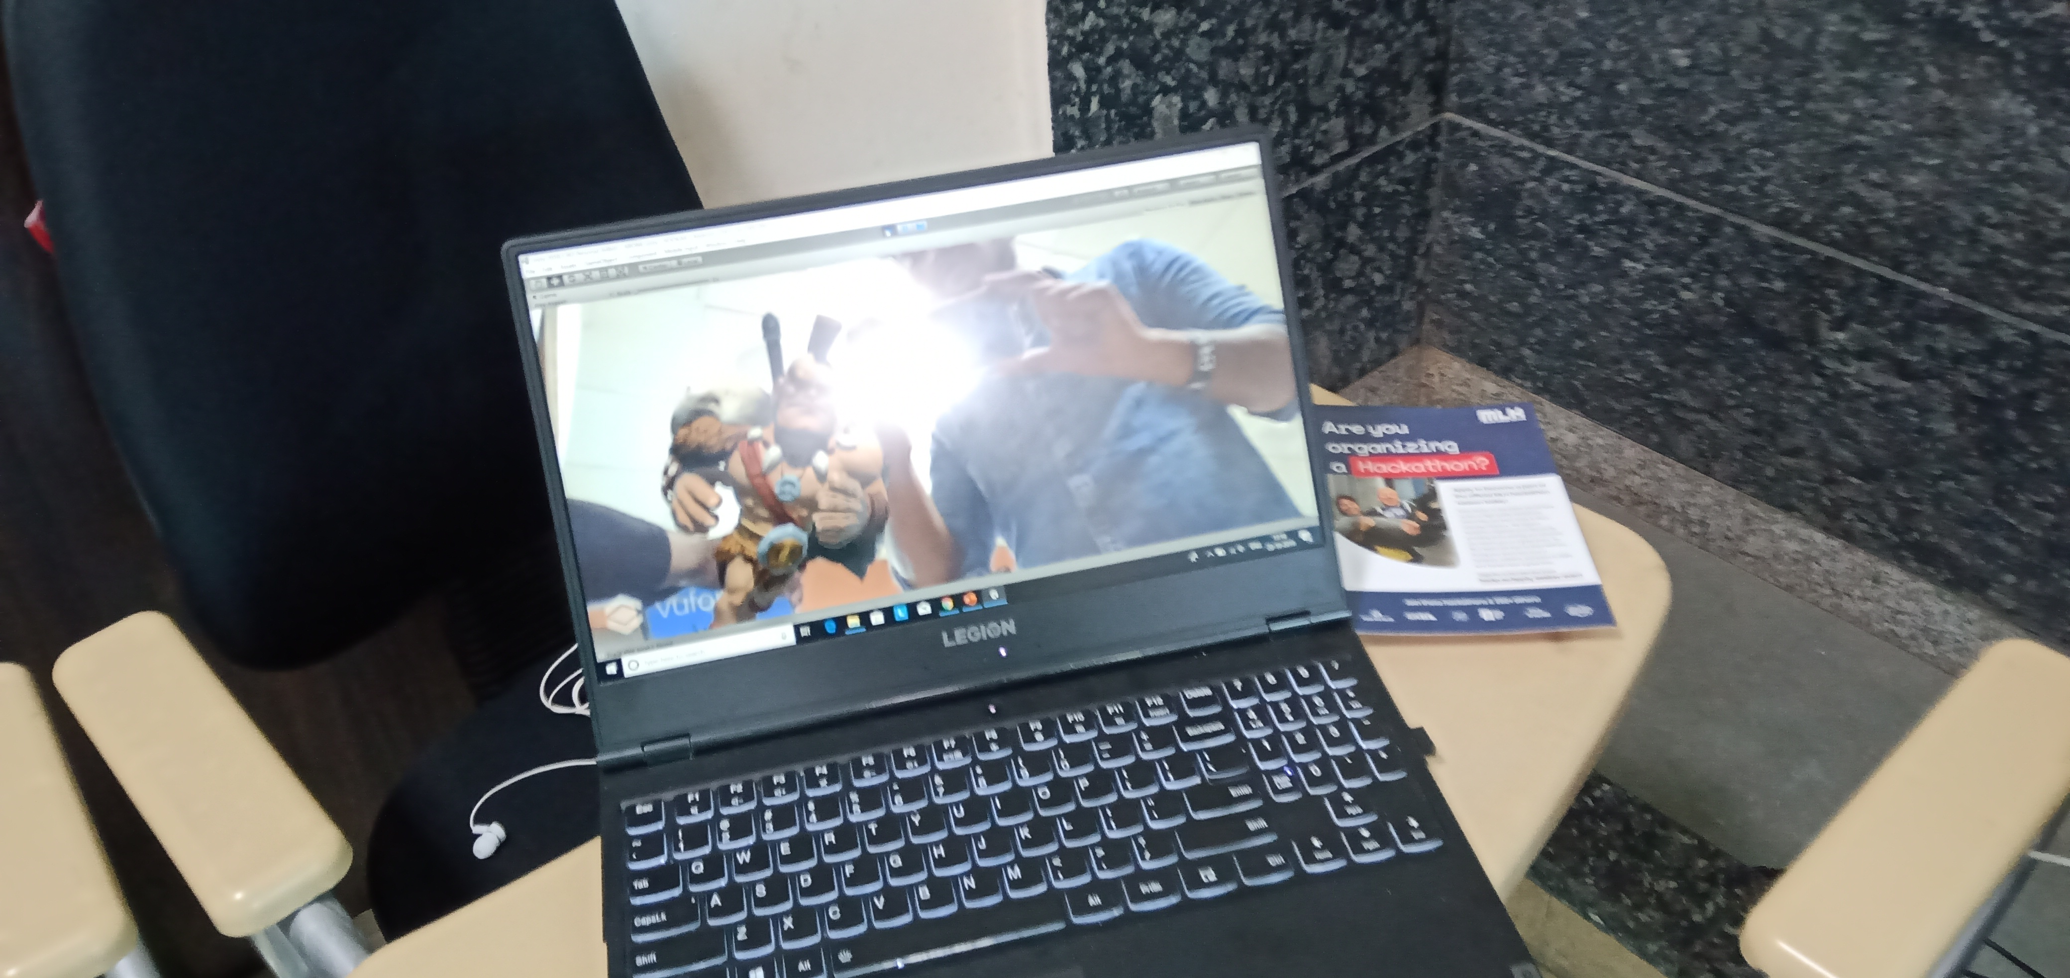
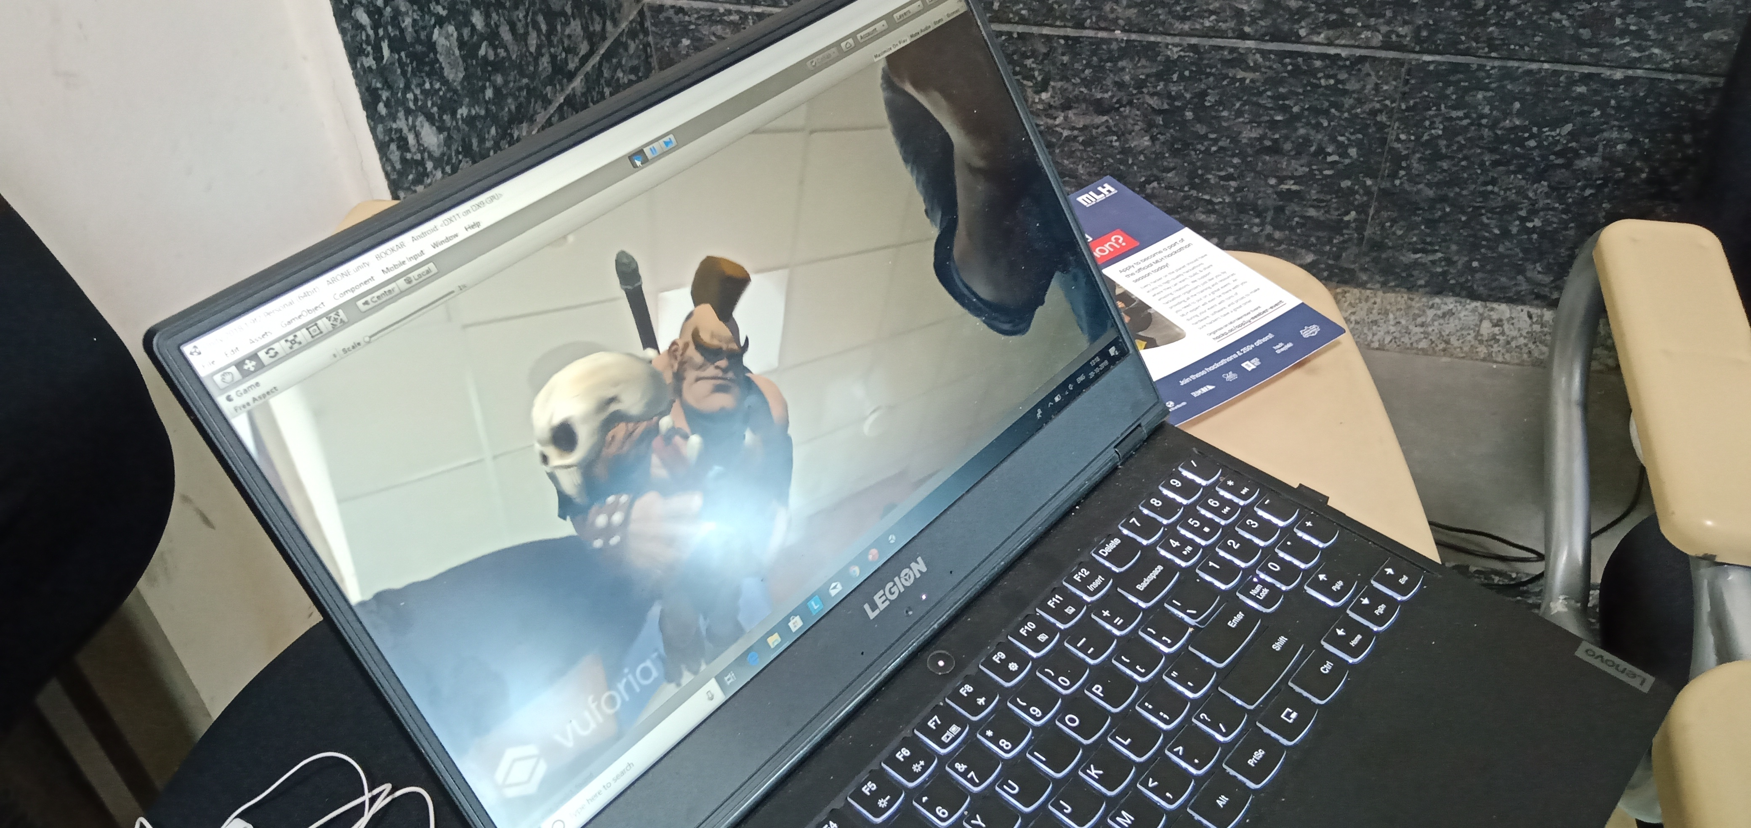
OUTPUT

Slide 5
Thank you

